Slide 1
B1 revision– How can we best prepare for out first assessment?
09/10/2026
Starter/R2R - Key word challenge:
Task: In the back of your books
Challenge: Answer the title question
Key Words:
See the above starter task…
Notes:
Google timer

Slide 2
Organelle | Cell | Tissue | Organ | Organ system | Prokaryotic / Eukaryotic Organism
Resolution / magnification / microscopy | Nucleus | Cytoplasm | Mitochondria | Chloroplast | Cell membrane
Genes (‘like recipes’) | Protein synthesis | Metabolism & Digestion | Aerobic / Anaerobic Respiration | Photosynthesis | Measuring the rate of photosynthesis
DNA Double Helix / Sugar Phosphate backbone | Lipase/ amylase/ protease | Enzymes | ATP | Limiting factor e.g. Light intensity | Phenolphthalein indicator for fatty acids (lipid digestion)
Bases (A-T, C-G) | Denature | Optimum pH/ temperature | Lactic acid/ Ethanol | CO₂ concentration | Accuracy, Validity (fair test), Precision, Reproducibility

Slide 3
Biology 1 (B1) Topics
Unit | Topic
B1 | Cells and their structures
 | Microscopy
 | Enzymes
 | Respiration
 | Photosynthesis
 | Investigative skills

Slide 4
Biology 1 (B1) Topics
Unit | Topic
B1 | Cells and their structures
 | Microscopy
 | Enzymes
 | Respiration
 | Photosynthesis
 | Investigative skills

Slide 5
Organelle | Cell | Tissue | Organ | Organ system | Prokaryotic / Eukaryotic Organism
Resolution / magnification / microscopy | Nucleus | Cytoplasm | Mitochondria | Chloroplast | Cell membrane
Genes (‘like recipes’) | Protein synthesis | Metabolism & Digestion | Aerobic / Anaerobic Respiration | Photosynthesis | Measuring the rate of photosynthesis
DNA Double Helix / Sugar Phosphate backbone | Lipase/ amylase/ protease | Enzymes | ATP | Limiting factor e.g. Light intensity | Phenolphthalein indicator for fatty acids (lipid digestion)
Bases (A-T, C-G) | Denature | Optimum pH/ temperature | Lactic acid/ Ethanol | CO₂ concentration | Accuracy, Validity (fair test), Precision

Slide 6
Biology 1 (B1) Revision
“The harder I work the luckier I get!”

Slide 7

Biology 1 (B1) Assessment
Next lesson– 50 mins only
Today is a chance to revise!!
Once we complete the test you will receive feedback and level up the next lesson!!

Slide 8
Assessment Skills
Key revision strategy - Retrieval practice….
Key word flash cards and question flash cards.
  Then test yourselves!
Key revision strategy – Practice exam application
Reading answering practice assessment questions.
  Then self-mark it! Ask for help when needed!!

Slide 9
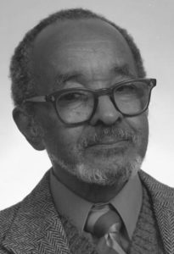
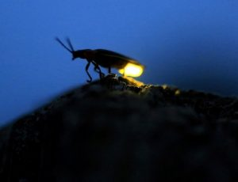
Emmett Chappelle – Black history month
While designing instruments for the Mars Viking spacecraft, he became interested in bio luminescence, which is warm light produced by living organisms.
Chappelle developed a method using two chemicals, luciferase and luciferin, from fireflies which give off light when mixed with ATP (adenosine triphosphate), an energy storage compound found in all living cells, to detect the presence of ATP.
This method for ATP detection can be used to detect life on other planets as well as microbiological organisms.

Slide 10
What is meant by a Eukaryotic / prokaryotic cell? | How do you calculate the magnification of an image? | An image of a cell is 5 cm in diameter. It has been magnified x 1000. What is the actual size of the cell? | How do we prepare cells to view down a microscope?
What is meant by the lock and key mechanism for enzymes? | What are meant by optimum conditions for an enzyme? | How does temperature/ pH/ substrate concentration effect the rate of an enzyme reaction? | State the names of 4 digestive enzymes (and their substrates).
How can we investigate the action of lipase? (think milk!) | What is the word and symbol equation for aerobic respiration? | Why do muscle cells have a lot of mitochondria? | What are the products of anaerobic respiration in animals and yeast?
Where does photosynthesis happen? | What are the three limiting factors of photosynthesis? | How can we investigate factors that effect the rate of photosynthesis? | How do you calculate a percentage of an amount?

Slide 11
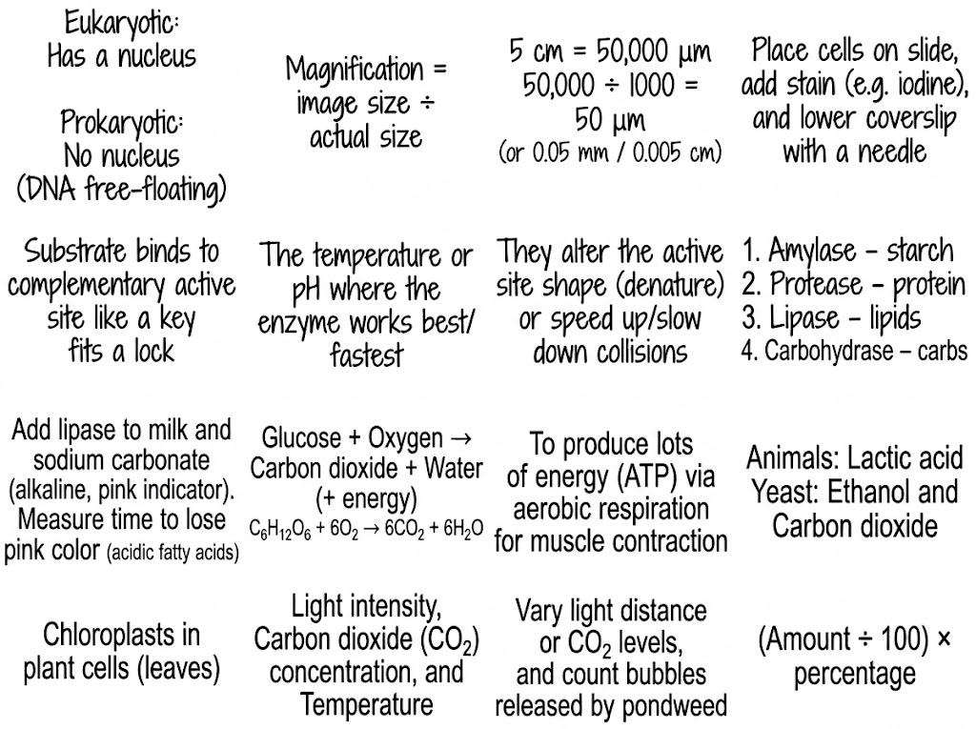

Slide 12
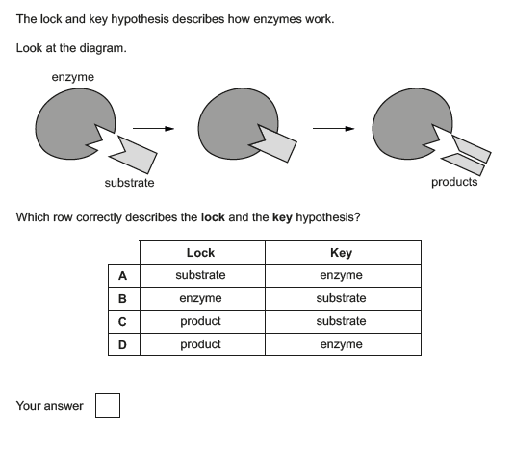
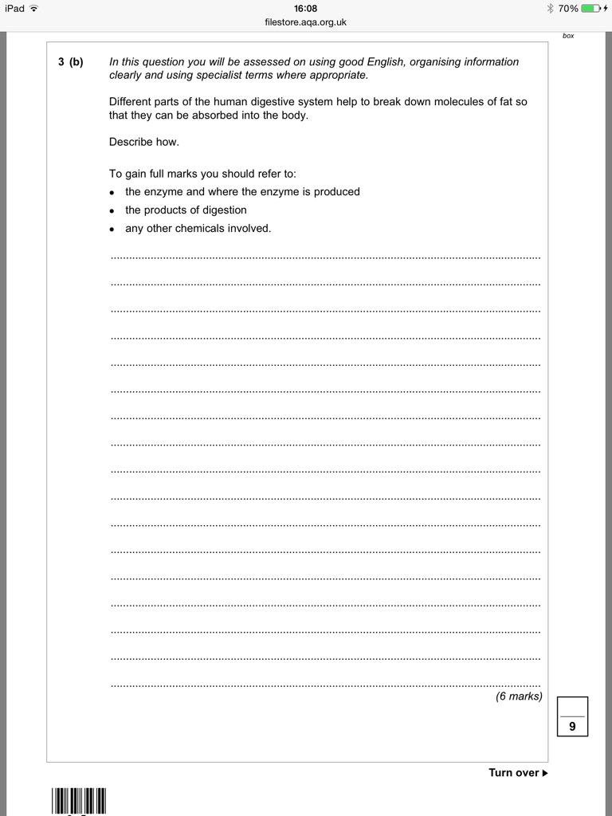

Slide 13
The enzyme that digests fat is called lipase. This enzyme is released in the small intestine.
This enzyme has an alkaline optimum pH of around 9.
When fats or lipids are digested, the products are 3 fatty acids and a molecule called glycerol.
A substance called bile helps to emulsify fats and so they can be more easily absorbed into the blood stream through the wall of the small intestine.
B
Half blood prince tips: We can investigate how quickly lipase enzymes work by using an indicator (Phenolphthalein) and milk (which contains fats). As the fats (lipids) break down, they release fatty acids which changes the colour of the indicator (and milk) from pink to colourless. This would leave the milk white!

Slide 14
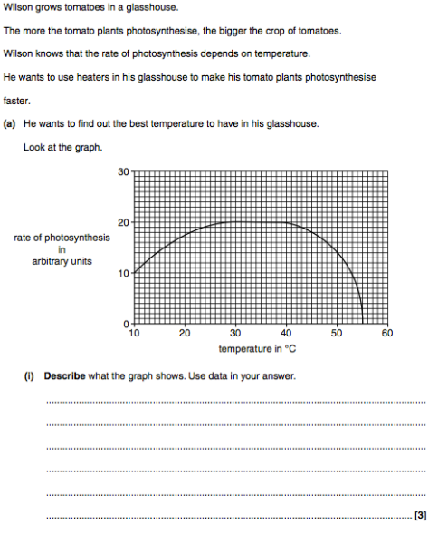
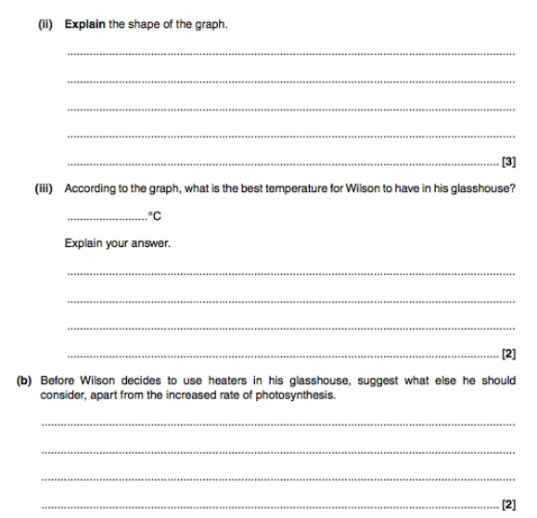

Slide 15
The rate of photosynthesis increases up until 28ºC as there is more energy for the reaction to happen quickly. After 40ºC the rate of photosynthesis decreases as the heat energy denatures the photosynthesis enzymes. At 55ºC the rate of photosynthesis is 0 as all the enzymes are denatured.
30
This is the lowest temperature where the rate of photosynthesis is at an optimum.
Half blood prince tips: The story of a graph is the story of the gradient (how steep the slope of the graph is).
Like every story there should be a beginning, a middle and an end!!
The rate of photosynthesis starts off quite low with a rate of 10 arbitrary units (a.u.) at 10ºC.
This gradually increases up until 28ºC where it levels off at 20 a.u. The rate of photosynthesis remains the same until 40ºC where the rate of photosynthesis begins to rapidly decrease.
At 55ºC the rate of photosynthesis is 0.
Wilson should consider if the light intensity is a limiting factor and therefore think about purchasing and installing LED lights in his glasshouse.

Slide 16
Biology 1 (B1) Revision
“The harder I work the luckier I get!”

Slide 17
Revision Video

